Slide 1

US Shale Oil & Gas Well Predictive Analysis
Andrew Cooper
Regis University
M.S. Data Science
October 2021

Slide 2

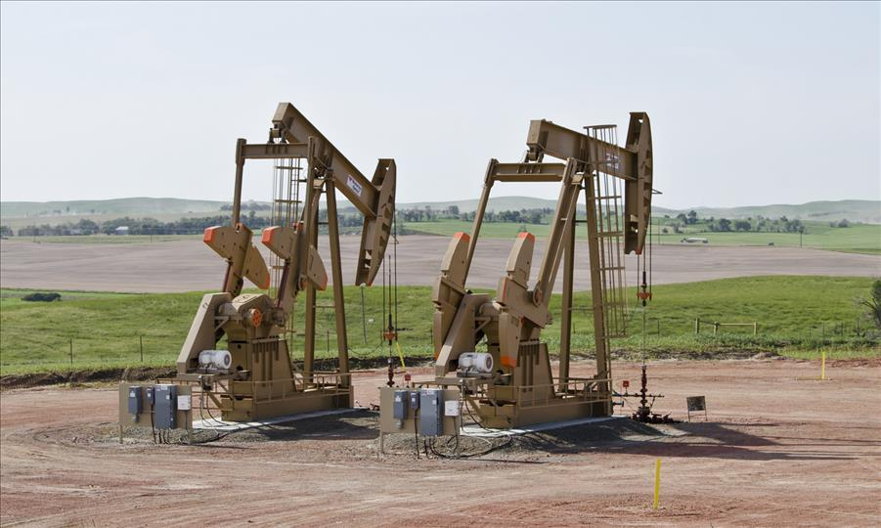


Project Overview
Acquire Data
Process Data
Exploratory Data Analysis
Feature Engineering
Model Prep | Testing
Model Interpretation
Research Question:
Investment companies commonly hire large teams of geoscientists to analyze how successful an oil and gas well might be given the geological environment.
Can big data and machine learning be used to predict whether a well is investable or not without the help of any geological specialists?
Goal of project is to collect different sources of oil and gas well data and develop a model to help these investment groups make accurate decisions on which wells to invest their capital into without any geological information
$$$

Slide 3

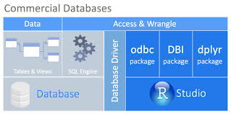




Data Acquisition

Slide 4
Data Acquisition
Final Dataframe Size → 115,650 X 28 = 3,238,200 Total Observations
Drilling Data
~114,552 Observations
~12 Features
Frac Data
~95,913 Observations
~4 Features
Production Data
~115,650 Observations
~14 Features

Slide 5
Data Processing
Create Target Variable for Classification
Aggregate Features For Single Well Record
Join 3 Independent Databases by Unique Key

Slide 6
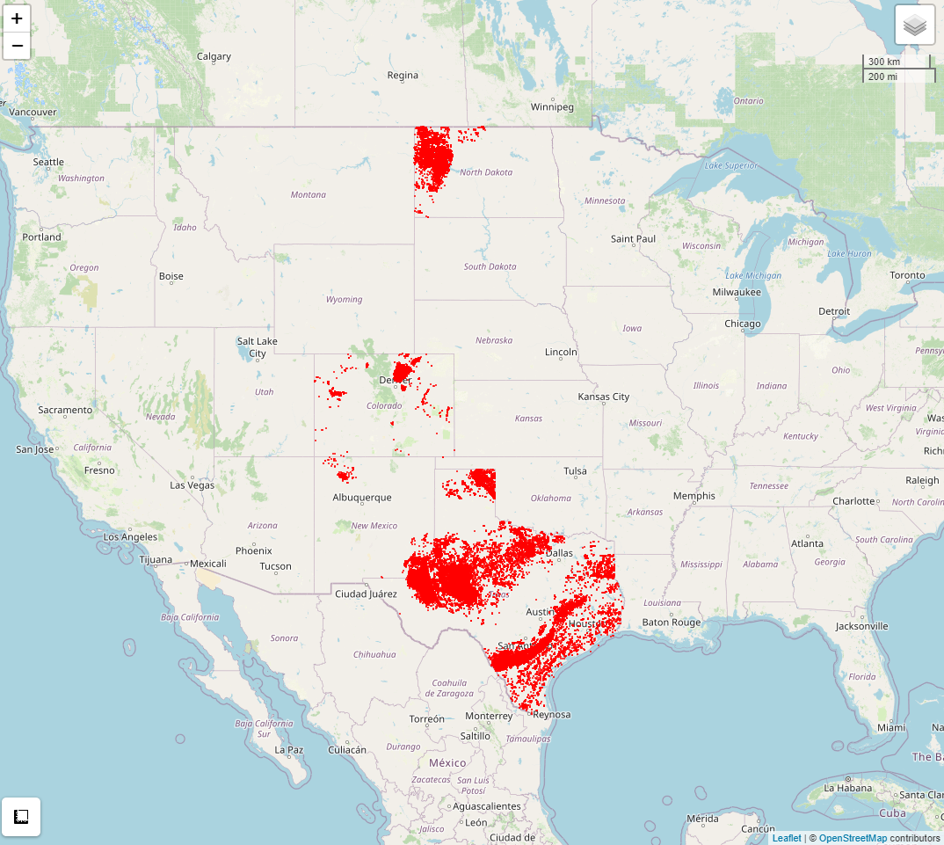
Exploratory Data Analysis

Slide 7
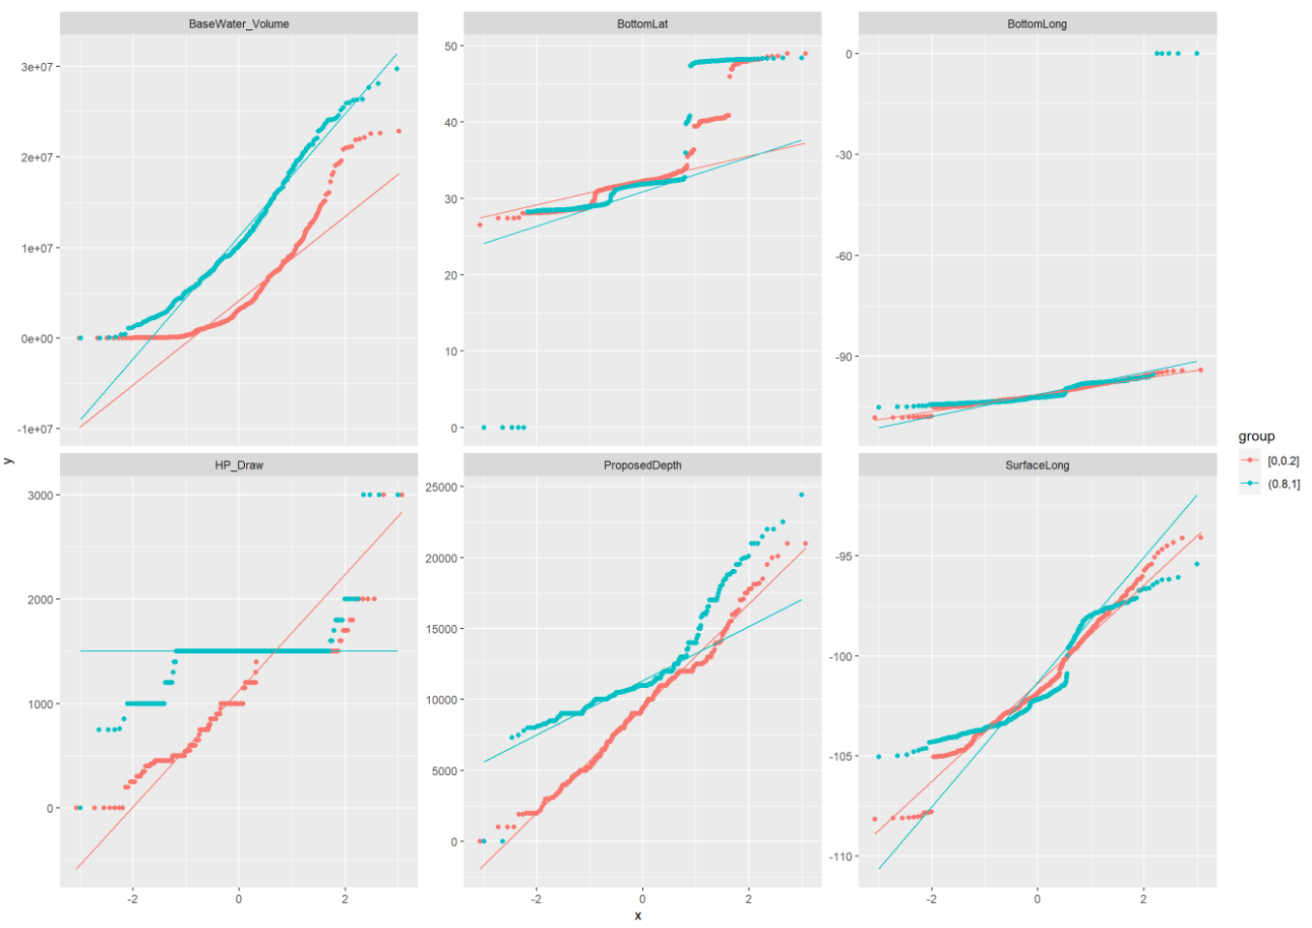
Exploratory Data Analysis

Slide 8
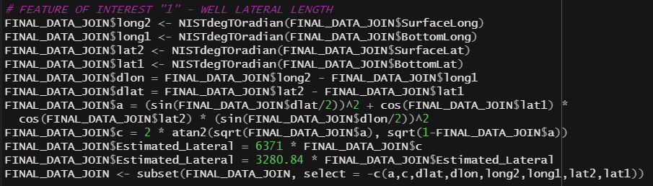
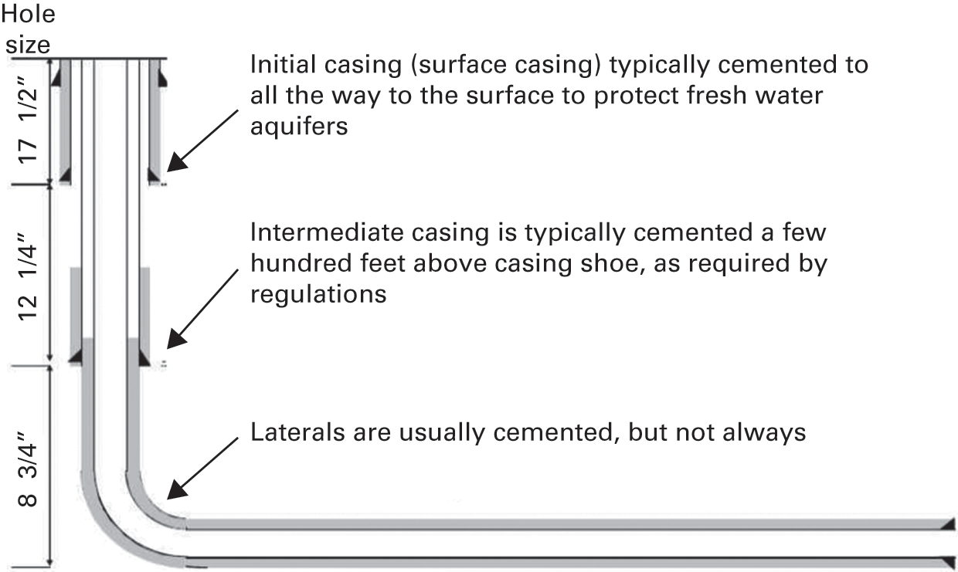
Feature Engineering
“Lateral Length”
“Water-to-Oil Ratio”
“Gas-to-Oil Ratio”
Variables to Potentially Improve Model Accuracy?
“Drill Days”
“Drill to Production Days”
“Frac Intensity”

Slide 9
Model Prep | Testing
# TEST VS SAMPLE SPLIT ###############################################################################
is.na(FINAL_DATA_JOIN) <- sapply(FINAL_DATA_JOIN, is.infinite)
FINAL_DATA_JOIN <- FINAL_DATA_JOIN[!(rowSums(is.na(FINAL_DATA_JOIN))),]
FINAL_DATA_JOIN$TargetWellPerformance <- as.factor(FINAL_DATA_JOIN$TargetWellPerformance)
FINAL_DATA_JOIN$ProdState <- as.factor(FINAL_DATA_JOIN$ProdState)
FINAL_DATA_JOIN$Drill_Type <- as.factor(FINAL_DATA_JOIN$Drill_Type)
FINAL_DATA_JOIN$Power_Type <- as.factor(FINAL_DATA_JOIN$Power_Type)
dt = sort(sample(nrow(FINAL_DATA_JOIN), nrow(FINAL_DATA_JOIN)*.7))
TRAIN <- FINAL_DATA_JOIN[dt,]
TEST <- FINAL_DATA_JOIN[-dt,]
Model 1:
Logistic Regression
Model 2:
Regression Decision Tree
Model 3:
Naïve Bayes

Slide 10
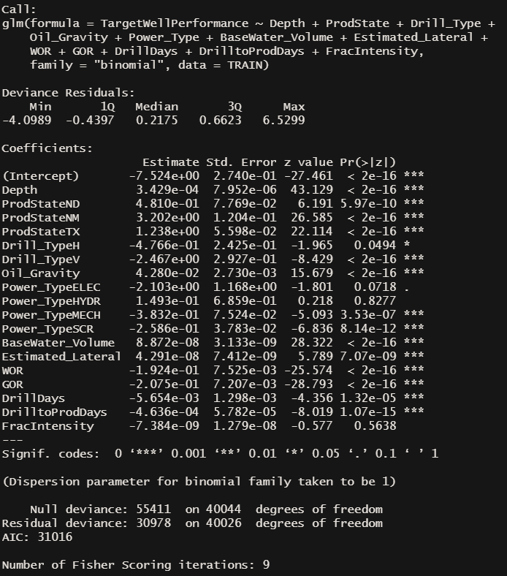
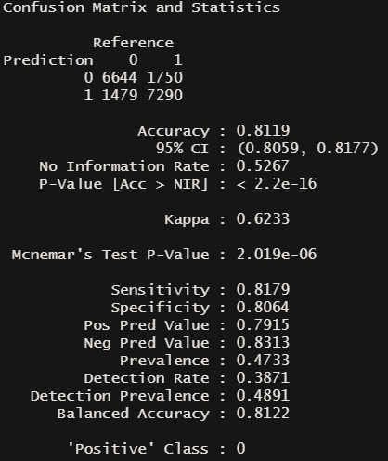
Best Model Interpretation

Slide 11
Final Thoughts
The most important factors to consider for an oil & gas well producer to reach “investable” status would be the following:
New Mexico provides the best land for investable wells, based on the strong significance factor & positive correlation
Wells should target lighter oil regions, as oil gravity or the weight has a strong correlation to investable
Gas or water heavy regions should be avoided, as they point toward a non-investable well
Producers should take the time to make sure their frac operations utilize a lot of injection fluid, as the higher the volume the stronger chance a well will enter the investable category

Slide 12

Project Publication | Conclusion
https://github.com/acooperminer15/OilGasWellPrediction
Dashboard Code:
Final-Blog-Workflow.Rmd
Exploratory Data Report:
EDA-Report.html
Final Presentation:
Final-Presentation-Data-Practicum-I.pptx
Raw Source Code:
Final-Project-SourceCode.R

